Slide 1
After Bologna was hijacked by the Nation States:
A European Statute?
Contribution to Conference: The Future of the European Universities after Bologna
Brussels, Dec. 13th, 2010
Jo Ritzen
President Maastricht University

Slide 2
Goal of Bologna: to create European Higher Education Area (EHEA)
(Warschau 1992) Goal to be achieved by:
Similar structure (BaMa) so that perception costs of study abroad decrease (Bologna 1998)
Grant Loan money follows students (Copenhagen, 1992)
Money (Government expenditures) should in principle follow students (Copenhagen, 1992) – yet unpractical
Measure for achievement:
20% EU mobility for full or part time study by 2010 (!)

Slide 3
What is advantage of EHEA?
Quality competition between countries for students
Developing a profile of a European graduate reflecting on international labour market
Quality competition between universities to European labour market profile
Higher sustainable economic growth

Slide 4
Complementarity between EHEA and European Research and Innovation Area
EU more and more important in research funding (FP’s/ERC/EIT)
More competition, higher quality
Higher efficiency in resolving major questions
Higher sustainable economic growth

Slide 5
Bologna was hijacked
Nationalisation of length, accreditation and quality control: perception and transaction cost still (too) high
Quality competition between countries is not rewarded: money does not follow students
Loan/grant money hardly follows students
Mobility still too low

Slide 6
Complementary to Bologona
Erasmus exchange: has reached saturation
Erasmus Mundus: too high costs of joint degrees because of different legal systems

Slide 7
New avenues are needed
European statute (answer to too high costs of different legal systems)
European finance (structural finance) for net immigration
European scholarship/loans

Slide 8
Innovation and Research: new avenues
Mobility of researchers limited by differences in pension rights between countries
Bilateral agreements on recognition of researchers from other countries (e.g. Germans are eligible for Dutch research support and reverse)

Slide 9
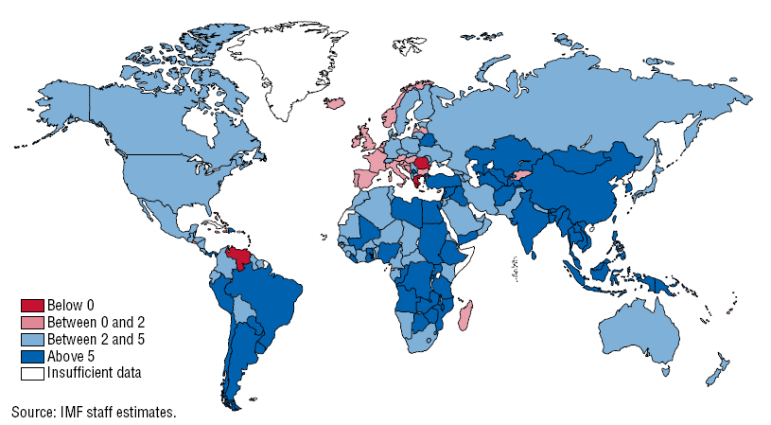
A Future around the Corner

Slide 10
A Future around the Corner

