Slide 1
The Role Of Australian Catholic Schools In Educating For Human Rights And Social Justice: An Overview Dr/Professor Sally Varnham

Slide 2
UTS located in Sydney Australia

Slide 3
UTS’s NEW DR Chau ChAk Wing Building

Slide 4
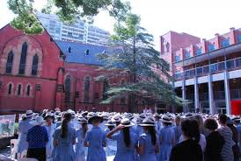
two aspects:
In the broad context of formal human rights education in Australian schools; and
From the perspective of practising human rights and citizenship within school programs:
Participation;
Social justice;
Restorative practice

Slide 5
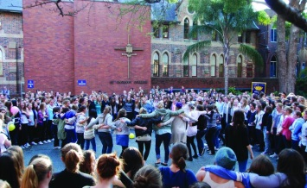
Framed by the right to and rights in education, This presentation will:
Outline the place of Catholic schools in the Australian system of compulsory education;
Consider human rights education generally in Australian schools and specifically within Catholic schools from the perspective of:
Formal education within the National Curriculum; and
Practising human rights and citizenship
Discuss the focus on social justice in Catholic schools, including restorative practice initiatives

Slide 6
A human right

Slide 7
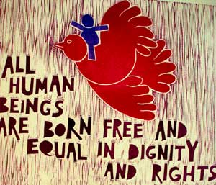
Declaration on Human rights education and training (United Nations adopted december 2011)
Art 1 defines human rights education as comprising:
All educational, training, information, awareness-raising and learning activities aimed at promoting universal respect for and observance of all human rights and fundamental freedoms and thus contributing … to the prevention of human rights violations and abuses by providing persons with the knowledge, skills and understanding and developing their attitudes and behaviours, to empower them to contribute to the building and promotion of a universal culture of human rights.

Slide 8
Key dimensions
Three key dimensions (Art 2):
Education about human rights;
Education through human rights;
Education for human rights
Inherent also is the right to participation as contained in Art 12 UNCROC – to express a view and to have that view taken into account – a fundamental right as a democratic citizen

Slide 9
Catholic schools within the Australian education system
Australia is a federation and education is a combination of state and federal funding, control and administration;
First Catholic school established in NSW in 1820 to educate children of the predominantly working class and poor;
Post-war – exponential rise to accommodate swelling Catholic population through immigration
National Catholic Education Commission supports at a national level the work of state and territory Catholic Education Commissions.
Both Catholic systemic and independent schools receive federal funding.
Now desirable choice for both Catholics and non-Catholics and educates one fifth of all Australian children

Slide 10
Parramatta marist high school australia’s oldest catholic school

Slide 11
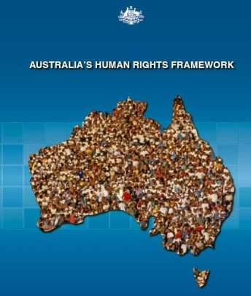
Human Rights Education within the national school curriculum
Melbourne Declaration of Educational Goals for all Australians 2008;
National Human Rights Framework – launched 2010
Human rights education fragmented across curriculum subjects
While it may be incorporated in various ways within the curriculum if is essentially the way in which we treat each other in the school community which provides the most resounding and enduring education

Slide 12
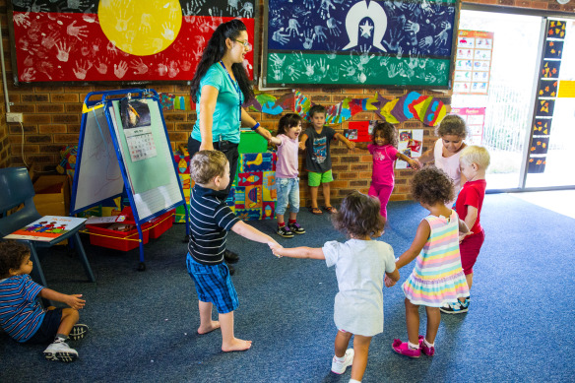
Practising human rights and social justice
Three main elements (Gerber & Pettitt):
Imparting and acquiring knowledge and skills;
Developing respectful attitudes reflecting human rights values;
Motivating social action

Slide 13
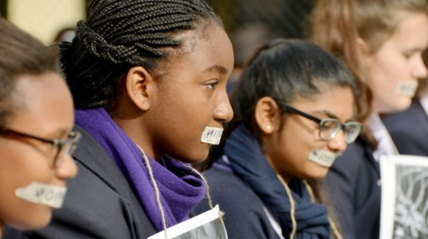
The Catholic system: education for human rights within the context of social justice
“Catholic school kids protest against asylum seeker policies
Catholic schools are taking a stand against children in detention, a policy they say violates basic human right and is inconsistent with their Christian values”
[Sydney Morning Herald, August 15, 2014]

Slide 14
.

Slide 15
What is Social justice?
Social justice
– difficult to define
– means different things to different people
– overlaid by ‘social, cultural, economic and political significance’ (Fraser, 2012)
But liberal view rooted in natural justice, fairness, full participation of all members of society, equality, respect for rights of others and responsibility as citizens
Models of addressing social injustice in Catholic schools based on social welfare, social change and eliminating causes of injustice.

Slide 16
Activity
Study ‘Human Rights Education in the School Curriculum’ (Burridge et al, 2013) pointed to feature of Catholic education system focus on social justice and social responsibility
2002 Social Responsibility (Catholic Education Commission)
Social justice community activities e.g. Caritas Australia
2014 Queensland Catholic Education Commission ‘Social Justice in Catholic Schools’ – to assist reflection on present practices and introduction of new programs. Sets out key principles for social justice in Catholic schools

Slide 17
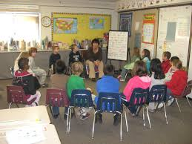
Restorative practices in Catholic school communities
A means of approaching anti-social behaviour and conflict within school communities from a basis of relationships, responsibility and respect.
Provides clear demonstration of a culture which respects and furthers principles and practice of human rights and social justice
At its core is the right to education in a safe, equal, hostile-free environment of all members of the school community

Slide 18
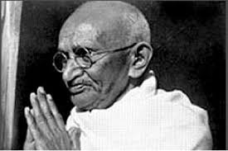
Where to begin
If we are to teach real peace in this world, and if we are to carry on a real war against war, we shall have to begin with the children. (Mahatma Gandhi, political and spiritual leader in India)

