Slide 1
A Comparative Analysis of Religious Freedom in Education:
An American Perspective
Educating Today and Tomorrow:
A Renewing Passion
European Education Law Association
20 November 2015
3.00-4.30 PM
Charles J. Russo, J.D., Ed.D. Panzer Chair in Education
Adjunct Professor of Law University of Dayton
001-937 229-3722 (ph)
crusso1@udayton.edu

Slide 2
Buon Giorno

Slide 3
Outline
I. Generally
II. Religious Freedom in Education
A) International Documents
B) United States
C) Schooling Internationally
D) Schooling in the US
III. Reflections/ Recommendations
V. Conclusion

Slide 4
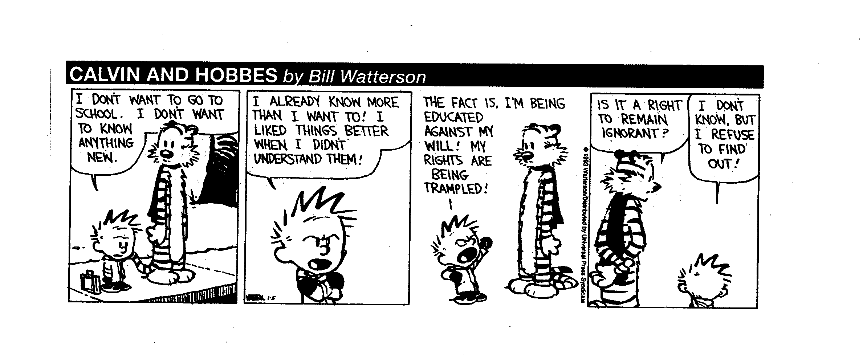

Slide 5
I. Generally
From the earliest times, whether in cave paintings in prehistoric France, Egypt, Greece, and Rome or the animistic belief systems in much of the rest of the world, humans recognized the need to call on a higher being as they engaged in what today is described as freedom of religion.

Slide 6
I. Generally
Yet, at the outset of the second decade of the Twenty-First Century, a tension exists between two fundamental human rights, freedoms to education and religion, especially as they interact in public or state-funded elementary and secondary schools.

Slide 7
I. Generally
Education, whether provided in state, confessional, or private, also known as non-public, religiously-affiliated, or faith-based schools in the US States, is essential because it holds the key to the future both for personal growth and fulfillment as well as by providing countries with a steady flow of well-informed citizens.

Slide 8
I. Generally
Under the euphemism of “control follows the dollar,” educational officials in confessional schools in Europe and elsewhere tend to have less freedom to direct their curricular content than religiously affiliated non-public schools in the US because they depend on the state, rather than tuition, for operating revenues.

Slide 9
I. Generally
Thus, leaders in many religious schools in the United States refuse to accept public funding so they can preserve curricular control and doctrinal purity.
An overlapping concern is religious freedom and the role of religion in state schools, not to mention what is taught in private religious schools where the values may be inimical to those of host nations.

Slide 11
I. Generally
The US, though, differs from much of the world because the judiciary and leaders have often than adopted the Jeffersonian metaphor calling for a “wall of separation” between Church and State that does not exist in many nations where there is freedom of religion.

Slide 12
I. Generally
Against the background, the rest of this talk examines the relationship between the rights to education and religion as what should be complementary fundamental human rights, particularly in terms of state funding.

Slide 13
I. Generally
Part II highlights relevant passages in international agreements and the US on the status of education and religion as fundamental human rights.
Part III focuses on funding in denominational, sectarian schools, religious, or faith based-schools in selected nations internationally and in the US.

Slide 14
I. Generally
Part IV reflects on the differences between similarities between the US and other nations while offering recommendations for practice before rounding out with a brief conclusion.

Slide 16
II. Religious Freedom in Education A) International Documents
Universal Declaration on Human Rights (1948)
(1) Everyone has the right to education. Education shall be free, at least in the elementary and fundamental stages. Elementary education shall be compulsory. Technical and professional education shall be made generally available and higher education shall be equally accessible to all on the basis of merit.

Slide 17
II. Religious Freedom in Education A) International Documents
Universal Declaration on Human Rights (1948)
(2) Education shall be directed to the full development of the human personality and to the strengthening of respect for human rights and fundamental freedoms. It shall promote understanding, tolerance and friendship among all nations, racial or religious groups, and shall further the activities of the United Nations for the maintenance of peace.

Slide 18
II. Religious Freedom in Education A) International Documents
Universal Declaration on Human Rights (1948)
(3) Parents have a prior right to choose the kind of education that shall be given to their children.

Slide 19
II. Religious Freedom in Education A) International Documents
Declaration on the Rights of the Child (1959)
Article 1. The child is entitled to receive education, which shall be free and compulsory, at least in the elementary stages. He shall be given an education which will promote his general culture and enable him, on a basis of equal opportunity, to develop his abilities, his individual judgment, and his sense of moral and social responsibility, and to become a useful member of society. . . .

Slide 20
II. Religious Freedom in Education A) International Documents
Declaration on the Rights of the Child (1959)
Article 14
1. States Parties shall respect the right of the child to freedom of thought, conscience and religion.
3. Freedom to manifest one's religion or beliefs may be subject only to such limitations as are prescribed by law and are necessary to protect public safety, order, health or morals, or the fundamental rights and freedoms of others.

Slide 21
II. Religious Freedom in Education A) International Documents
The Declaration on the Rights of Persons
Belonging to National or Ethnic, Religious
and Linguistic Minorities (1992)
Article 1
States shall protect the existence and the national or ethnic, cultural, religious and linguistic identity of minorities within their respective territories and shall encourage conditions for the promotion of that identity.

Slide 22
II. Religious Freedom in Education A) International Documents
The Declaration on the Rights of Persons
Belonging to National or Ethnic, Religious
and Linguistic Minorities (1992)
Article 2
1. Persons belonging to national or ethnic, religious and linguistic minorities (hereinafter referred to as persons belonging to minorities) have the right to enjoy their own culture, to profess and practice their own religion, and to use their own language, in private and in public, freely and without interference or any form of discrimination.

Slide 23
II. Religious Freedom in Education A) International Documents
Int’l Covenant on Civil and Political Rights (1994)
Article 18
Everyone shall have the right to freedom of thought, conscience and religion. This right shall include freedom to have or to adopt a religion or belief of his choice, and freedom, either individually or in community with others and in public or private, to manifest his religion or belief in worship, observance, practice and teaching.

Slide 25
II. Religious Freedom in Education B) The United States
First Amendment, 1791
“Congress shall make no law respecting an
establishment of religion, or prohibiting the free
exercise thereof.”

Slide 26
II. Religious Freedom in Education B) The United States
Appeals to history over the original intent of the Establishment Clause fail to provide clear answers, stemming largely from the close ties between religion and government that began during the colonial period.

Slide 27
II. Religious Freedom in Education B) The United States
In fact, up until the Revolutionary War, there “. . . were established churches in at least eight of the thirteen former colonies and established religions in at least four of the other five.” Engel v. Vitale, 370 U.S. 421, 428 n. 5 (1962).

Slide 28
II. Religious Freedom in Education B) The United States
This is all tempered by Jefferson’s 1802 Letter to the
Danbury Baptist Association
Believing with you that religion is a matter which lies solely between man and his God . . . I contemplate with sovereign reverence that act of the whole American people which declared that their legislature should “make no law respecting an establishment of religion, or prohibiting the free exercise thereof,” thus building a wall of separation between church and state.

Slide 29
II. Religious Freedom in Education B) The United States
The metaphor of the “wall of separation” traces its origins to Roger Williams who coined the term more than 150 years before Thomas Jefferson used it in his letter to the Danbury Baptist Convention. Roger Williams

Slide 30
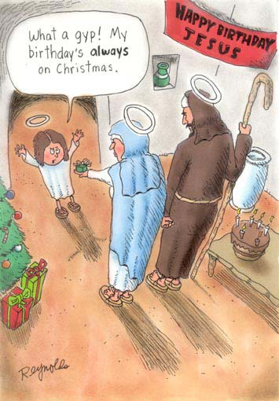

Slide 31
II. Religious Freedom in Education C) Schooling Internationally
Varying Levels of State Funding
for Religious Schools in Selected Nations
Australia Italy
Belgium Netherlands
England New Zealand
Ireland South Africa (generally low)

Slide 32
II. Religious Freedom in Education C) Schooling Internationally
Differentiated Funding
Canada
Alberta, Ontario, Saskatchewan fund RC schools but per Adler v. Ontario (1996) no duty to fund Jewish schools
Alberta, British Columbia, Manitoba, Saskatchewan, Quebec, fund independent, generally religious, schools
New Brunswick, Newfoundland and Labrador, Nova Scotia, Ontario, Prince Edward Island do not fund independent religious schools

Slide 33
II. Religious Freedom in Education C) Schooling Internationally
No Direct Funding
France . . . laïcité
United States. . . “wall of separation”

Slide 34
II. Religious Freedom in Education C) Schooling in the US
Pierce v. Society of Sisters, 268 U.S. 510 (1925)
A “Magna Carta” for non-public schools, the Supreme
Court recognized the power of the state “reasonably to
regulate all schools, to inspect, supervise, and examine
them, their teachers and pupils ... (p. 534),” but focused
on the schools’ Fourteenth Amendment property rights.

Slide 35
II. Religious Freedom in Education C) Schooling in the US
The Court grounded its judgment on the realization that
the schools sought protection from unreasonable
interference with their students and the destruction of
their business and property.

Slide 36
II. Religious Freedom in Education C) Schooling in the US
The Court added that while states may oversee such key
features as health, safety, and teacher qualifications
relating to the operation of non-public schools, they
could not do so to an extent greater than they did for
public schools.

Slide 38
II. Religious Freedom in Education C) Schooling in the US
1. Student Transportation
Everson v. Board of Educ. (1947) (1st Establishment Clause case and education)
But see Wolman v. Walter (1977)

Slide 39
II. Religious Freedom in Education C) Schooling in the US
2. Text Books and Instructional Materials
Cochran v. Louisiana State Board of Education (1930)
cf. Abington v. Schempp, Murray v. Curlett (1963)
Board of Education v. Allen (1968)
Meek v. Pittenger (1975)
Wolman v. Walter (1977)
Mitchell v. Helms (2000)

Slide 40
II. Religious Freedom in Education C) Schooling in the US
3. Use of Public Funds I
Walz v. Tax Commission of City of N.Y. (1970)
cf. Abington v. Schempp, Murray v. Curlett (1963)
Lemon v. Kurtzman (1971)

Slide 41
II. Religious Freedom in Education C) Schooling in the US
THE Lemon Test
“Every analysis in this area must begin with
consideration of the cumulative criteria developed by
the Court over many years. Three such tests may be
gleaned from our cases. . . .

Slide 42
II. Religious Freedom in Education C) Schooling in the US
First, the statute must have a secular legislative purpose;
second, its principal or primary effect must be one that
neither advances nor inhibits religion;
finally, the statute must not foster ‘an excessive
government entanglement with religion.’” (pp. 612-13)

Slide 43
II. Religious Freedom in Education C) Schooling in the US
In addressing entanglement and state aid to religiously
affiliated institutions, the Court noted that three
additional factors:

Slide 44
II. Religious Freedom in Education C) Schooling in the US
“we must examine the character and purposes of the
institutions that are benefitted,
the nature of the aid that the State provides,
and the resulting relationship between the government
and religious authority.” (p. 615)

Slide 45
II. Religious Freedom in Education C) Schooling in the US
4. Student Services/ Secular Instruction
Meek v. Pittenger (1975)
Wolman v. Walter (1977)
Aguillar v. Felton (1985)
Zobrest v. Catalina Foothills School District (1993)
Grument v. Kyrias Joel (1994)
Agostini v. Felton (1997)

Slide 46
II. Religious Freedom in Education C) Schooling in the US
5. Use of Public Funds
Zelman v. Simmons-Harris (2002) Vouchers . . . Could be key, similar to much of Europe

Slide 47
III. Reflections-Recommendations
What nations of the world learn from each other
1. Provide more funding to religious schools . . .
But perhaps with fewer strings attached . . .

Slide 48
III. Reflections-Recommendations
2. Consistent with internationally accepted norms, leaders must act to have the right to religious education explicitly recognized and protected as a fundamental right for all children.

Slide 49
III. Reflections-Recommendations
3. National leaders must provide adequate funding to create schools to provide children of all faiths with a world-class education.

Slide 50
III. Reflections-Recommendations
4. Treat education, religious and secular, as an integrative factor, one designed to help prepare all children to become productive members of their societies rather than set them apart based on religion or other personal characteristics.

Slide 51
III. Reflections-Recommendations
5. School systems must be open to all children, staffed by educators who teach respect for religiously pluralistic, cross-cultural principles respecting international norms; systems must be inclusive, not exclusive.

Slide 52
III. Reflections-Recommendations
6. Laws and policies must be enacted to meet the educational needs of religious minorities while respecting the laws of host nations and internationally accepted norms about treatment of individuals outside of their own communities.

Slide 53
III. Reflections-Recommendations
7. Institutions of higher learning must enhance teacher and administrator preparation programs by including instruction about dealing with religious issues so as to be better able to educate children of all faiths.

Slide 54
III. Reflections-Recommendations
8. Schedule conferences/ meetings on religious freedom in education such as this regularly to obtain input from all stakeholders, including, but not limited to, parents, students, teachers, civil leaders, interested in helping to ensure equal educational opportunities for all children.

Slide 55
III. Reflections-Recommendations
9. In light of the rapid pace at which change occurs, leaders should regularly re-evaluate and update plans for providing equitable educational opportunities for all children.

Slide 56
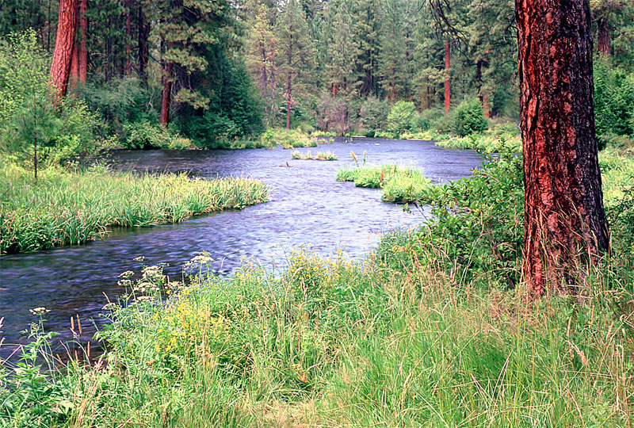
V. Conclusion
One cannot step into the same river twice.
Heraclitis

Slide 57
Thank you for listening
and participating
Molte Grazie
Ciao

