Slide 1
European Perspective:
Youth on the Move and EU Modernisation Agenda for Higher Education
Jerusalem, 24-25 November 2010
Conference on the future of the European Universities after Bologna, 13 December 2010, Brussels
Sophia Eriksson Waterschoot
European Commission – Unit for Higher Education Policy and Erasmus

Slide 2
Outline
The Challenge: a Europe with increasing skills needs
A European Response: Europe 2020 – a strategy for smart, sustainable and inclusive growth
Flagship initiatives: Youth on the Move
        New Skills and New Jobs
What next: how can HE systems respond to the challenges?

Slide 3
1 – The Challenge
A Europe with increasing skills needs

Slide 4
What will the EU labour market look like
10 years or so from now?
Employment in 2020:
  7 million new jobs (+ 73 million jobs due to replacement)
Jobs becoming more knowledge- and skills-intensive
Jobs employing highly qualified people > 1/3; by 2020 35% of all jobs will require high-level qualifications (today 29%)

Slide 5
More jobs for the better qualified

Slide 6
2 – A European Response
Europe 2020:
a strategy for smart, sustainable and inclusive growth

Slide 7
A European Response:
If higher education is so important – what are we doing about it?
Higher education, at the centre of our strategy for growth and prosperity:
  Europe 2020 Strategy
  ‘Youth on the Move’
  ‘An Agenda for New Skills and Jobs’
  A strategy for the Modernisation of Higher Education

Slide 8
What can the
European Commission do?
Education Policy = national competence
  « the EU’s role is to contribute to the development of quality education by encouraging cooperation between Member States and, if necessary, by supporting and supplementing their action » (Lisbon Treaty)
Develop the European dimension in education, encourage mobility and cooperation between universities
Open method of co-ordination (benchmarking and peer learning amongst Member States)
Strategic reflection and policy shaping
Specific initiatives and instruments
8
Notes:
8

Slide 9
Over-arching EU policy goal:
The Europe 2020 Strategy
“Europe 2020 is about what we need to do today and tomorrow to get the EU economy back on track […] We need to build a new economic model based on knowledge, low-carbon economy and high employment levels."
Europe 2020, June 2010
“
Three interlocking and mutually reinforcing priority areas:
Smart growth - developing an economy based on knowledge and innovation;
Sustainable growth - promoting a low-carbon, resource-efficient and competitive economy;
Inclusive growth - fostering a high-employment economy delivering social and territorial cohesion

Slide 10
Europe 2020 Benchmarks
Education:
   the share of early school leavers to 10% (currently 14%)
   increase the share of the population aged 30–34 having completed tertiary education to at least 40% (currently 32%)
Employment:  employment rate to > 75%
Research and development:  investment in to 3% of GDP
Energy:  greenhouse gas emissions by > 20% &  share of renewable energy to 20%, and  energy efficiency by 20%
Poverty:  the number of Europeans living below national poverty lines by 25%
10
Notes:
10

Slide 11
40% HE attainment benefits of a university education

Slide 12
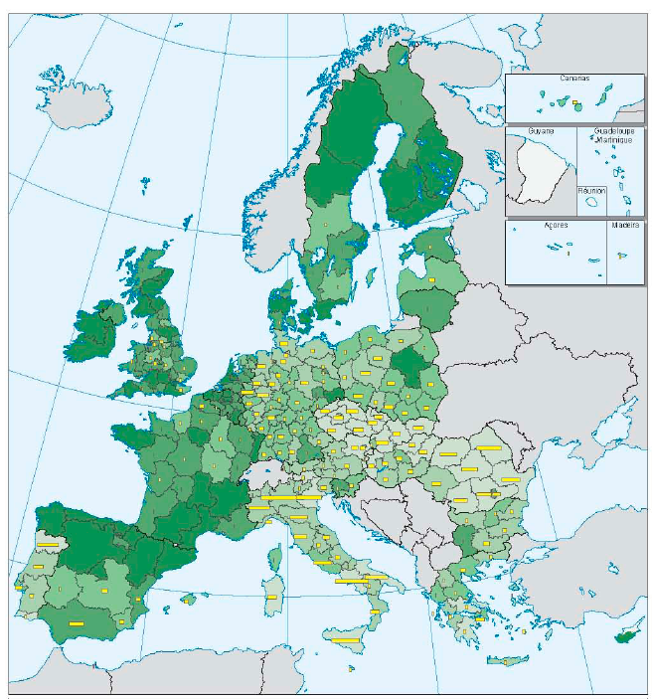
How are we doing compared to the European Benchmark?
(40% of 30-34yr olds to be qualified at HE level by Europe 2020)

Slide 13
More people should reap the benefits of a university education
How will Europe reach the 40% benchmark?
  make higher education attractive to more school leavers and widen participation to non-traditional learners (e.g. mature students, disadvantaged backgrounds, minority groups)
  Reduce drop-out rates
  More flexible learning and attendance modes
  Facilitate pathways from VET to HE
Each country will set a national target appropriate to their own circumstances
University might not be for everyone and VET should be a valuable alternative

Slide 14
But can our higher education systems cope?
Capacity
  Enough places?
  Enough money to pay for expansion?
  Enough professors – retirement time bomb?
Is there a trade off between quality and quantity?
Massification - diminishing exceptionality?
Competition for students – more profiling of HEIs?

Slide 15
3 – European Response: Flagship initiatives to drive progress
      Youth on the Move
      New Skills and Jobs

Slide 16
Youth on the Move
An integrated strategy for young people, embracing both education/training and employment
(adopted 15th Sept 2010)
“
Modern education and training systems: improving schools, VET, recognition of non-formal/informal learning
Higher education: making higher education more attractive and effective
Learning and employment mobility: promoting training + work abroad as a way to gain skills / experience
Youth Employment Framework: active labour market policies + reform of labour market rules

Slide 17

Youth on the Move: Higher Education
Communication on modernising HE: a new agenda on employability, mobility, transparent info on study and research, internationalisation strategy (2011)
Results of study on multi-dimensional global university ranking (2011)
Multiannual Strategic Innovation Agenda: role of EIT, priorities for HE, research, innovation and entrepreneurship (2011)

Slide 18
Youth on the Move: Learning Mobility”
Youth on the Move website on EU learning and mobility opportunities
Council Recommendation on learning mobility + Mobility Scoreboard (adopted + 2012)
EU mobility benchmarks Communication (2011)
Guidance on the rights of mobile students (ECJ rulings) (adopted)
European Skills Passport (building on Europass, covering informal/non formal learning) (2011-2012)

Slide 19
An Agenda for New Skills and Jobs
European Council request: « to present a comprehensive assessment of the future skills requirements in Europe up to 2020 taking account of the impacts of technological change and ageing populations and to propose steps to anticipate future needs »
“
Commission Communication: New Skills for New Jobs: anticipating and matching labour market and skills needs (Dec 2008)
Forecasting of Skills Supply and Demand to 2020 – and beyond
Sectoral Level Analyses: 19 foresight studies (Summer 2009)
Expert Group Report: New Skills for New Jobs: Action Now (Feb 2010)
Commission Communication: An Agenda for New Skills and Jobs (Nov 2010) - to inter alia give people and businesses the right incentives to invest in continuous training, reduce mobility barriers, improve the recognition of professional qualifications...

Slide 20
Modernisation of Higher Education
'The last decade has brought about major expansion in higher education systems, accompanied by significant reforms in degree structures and quality assurance systems. We must continue to modernise and increase the quality of higher education, as well as making it more affordable for citizens’ Androulla Vassiliou, European Commissioner for Education, Mar 2010
“
Bologna process: 47 countries to make European higher education more compatible, comparable, competitive and attractive for students
EU Modernisation of HE agenda: enabling Europe’s universities to contribute to the creation of a true knowledge economy and society
  Commission Communication (2006) identified 9 challenge areas and proposed reforms in curricula, governance and funding
  Commission Communication (2011) …

Slide 21
4 - What next?
How can HE systems respond to challenges?

Slide 22
What will HE systems look like in the next 10 years or so?
How can higher education be responsive to the needs of society and the labour market but also shape the future?
What do countries and regions need?
What do students want?
What do employers want?

Slide 23
What next: how can HE systems respond?
Higher Education has never been higher on the EU agenda
Reforms are needed to allow universities to play their full part in driving smart, sustainable and inclusive growth
No one-size-fits-all: each country may find their own solutions
Learning from each other will help to advance the modernisation agenda
European programmes and policy debate can provide support and impetus
23
Notes:
23

Slide 24
What next: new challenges?
Increased pressure on capacity, quality and financial resources due to massification of Europe’s HE systems
Pressure on financial resources intensified as a consequence of the economic crisis
Graduate employability: an increasingly important theme at the European, national and institutional level. More qualitative research needed
Widening participation: To achieve the EU 40% benchmark
Expanded role of transparency tools: increasing demands from the users of education to know more of its contents and outcomes
Strong political commitment to mobility
24
Notes:
24

Slide 25
Commission Communication on the Modernisation of Higher Education
(Autumn 2011)
Policy document – setting out key challenges, opportunities and recommending action at EU and Member State level (to 2020)
Key theme: How to achieve massification whilst maintaining high quality provision
To include an internationalisation strategy: how can European HE be more attractive to students and academics from beyond our borders; how can we co-operate better
Public online consultation end December to end February
Informed by consultation with governments and mutual learning
Specific studies/research e.g. Feasibility studies on performance tool (June 2011), pan-EU student lending facility (March 2011)
25
Notes:
25

Slide 26
Find out more …
European Commission – Education webpages:
http://ec.europa.eu/education/index_en.htm
Feel free to contact me: sophia.eriksson@ec.europa.eu

